Slide 1
The participation rate of SAT exams
Steve Lee

Slide 2
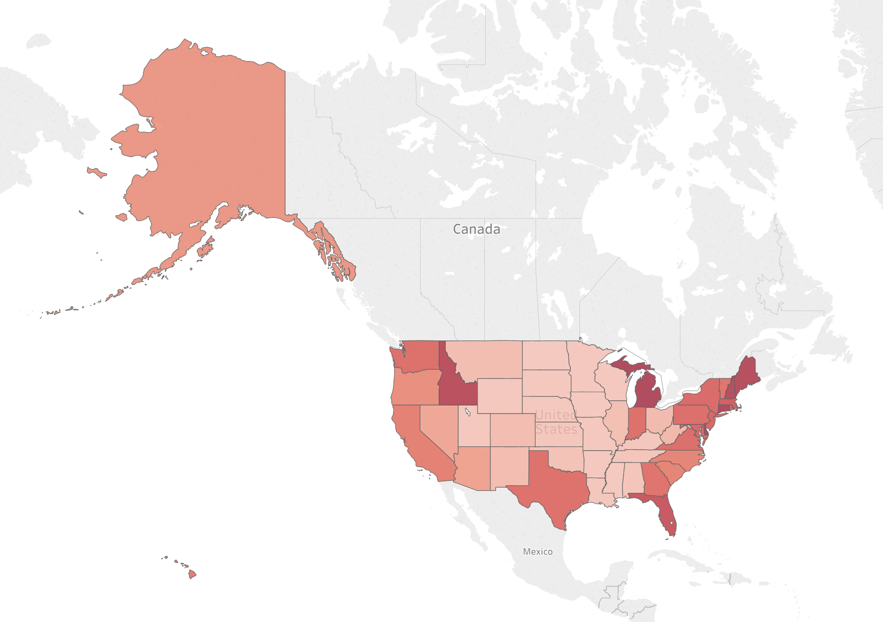
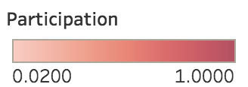
States with Low Rates
23 States had < 20% participation rate of taking the SAT (2017)
SAT is much less popular than ACT in MidWest
Many states in that region require each student take the ACT as part of statewide assessments

Slide 3
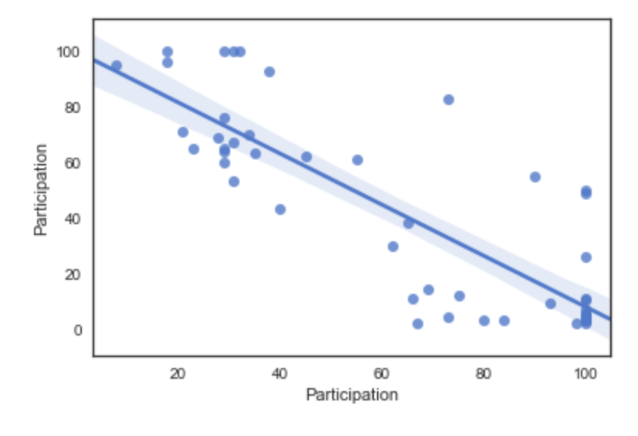
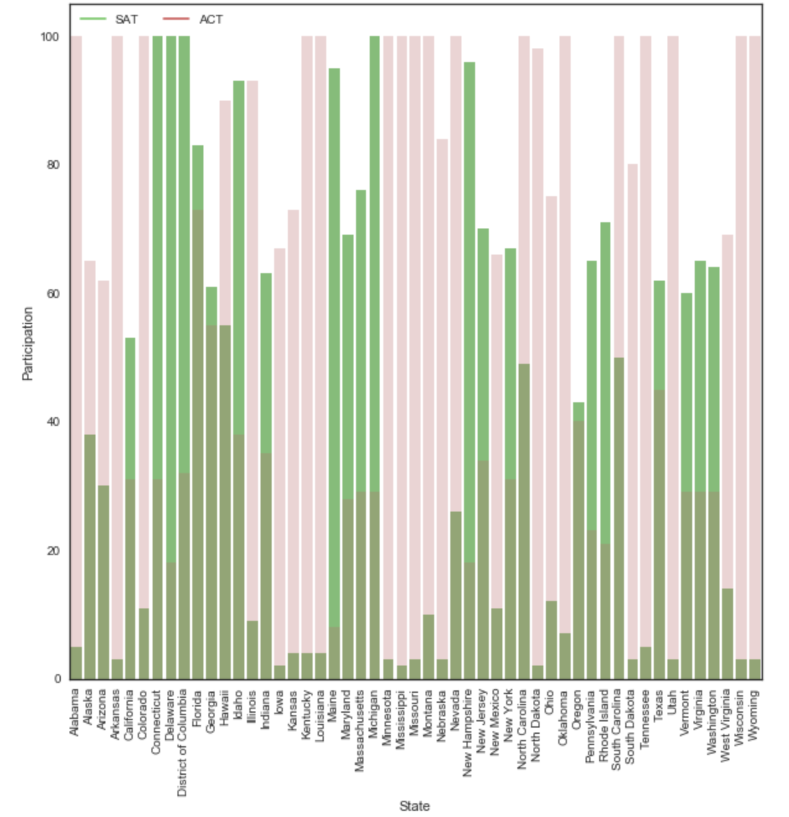
SAT vs. ACT
Unsurprisingly, students choose to take only one of exams
Number of students taking SAT is decreasing
( ACT is increasing)
The number of students taking ACT passed SAT around 2014

Slide 4
Why Student Choose ACT?
Shrewd marketing
Some states now require students to take the ACT and provide state funding for the test
No scoring penalty on ACT
SAT penalizes you for wrong answers
ACT is scored based on the number of correct answers with no penalty for guessing
SAT changed its format on 2016.
Required writing section on SAT
mandatory writing section, whereas the ACT makes the writing test optional.
ACT has been cheaper than SAT
SAT has reduced its registration fee
SAT($46 - $60) / ACT ($46- $62.5)
Source: 12 Reasons More Students Are Taking The ACT Instead Of The SAT
(https://schoolmatch4uproducts.com/12-reasons-students-taking-act-instead-sat/)

Slide 5
How to improve
Promote SAT fee waivers for low income family
Encourage students to take the SAT through colleges/universities

